Slide 1
Spatially Resolved Transcriptomics by Spot-based capture and sequencing
Prof. Jean Fan

Slide 2
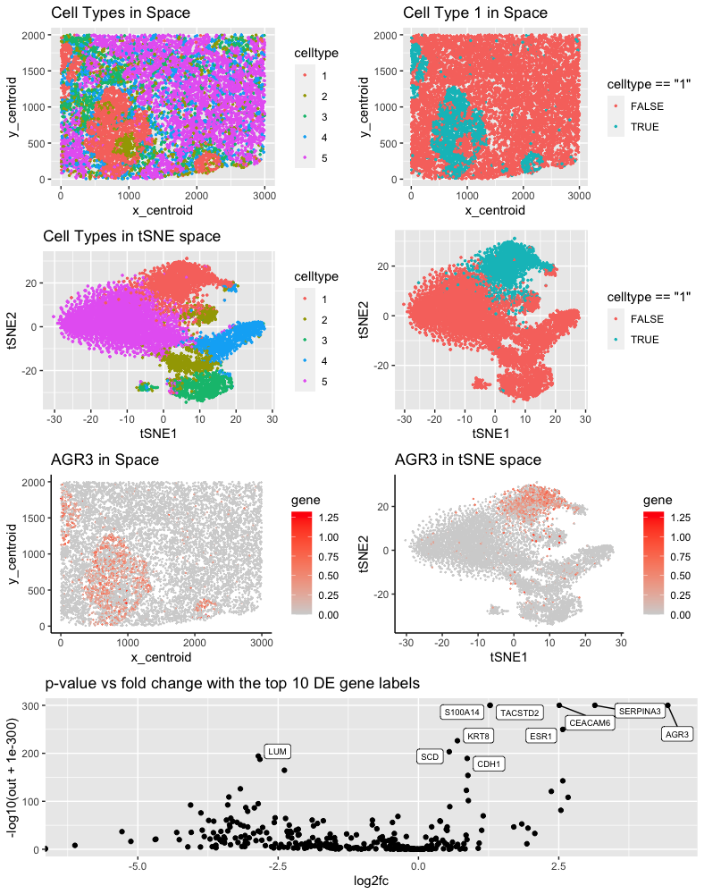
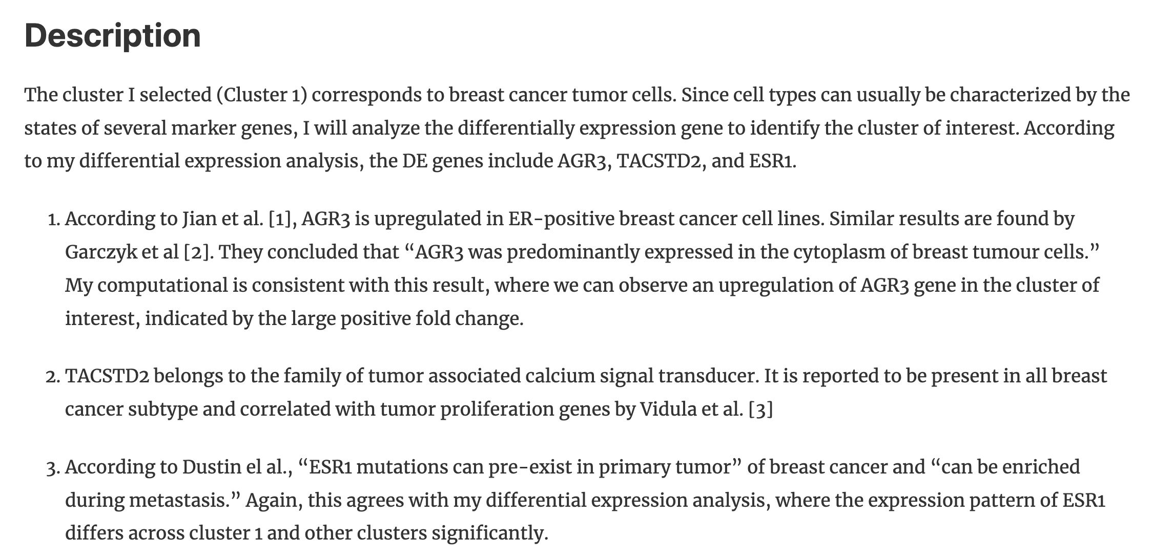

Slide 3
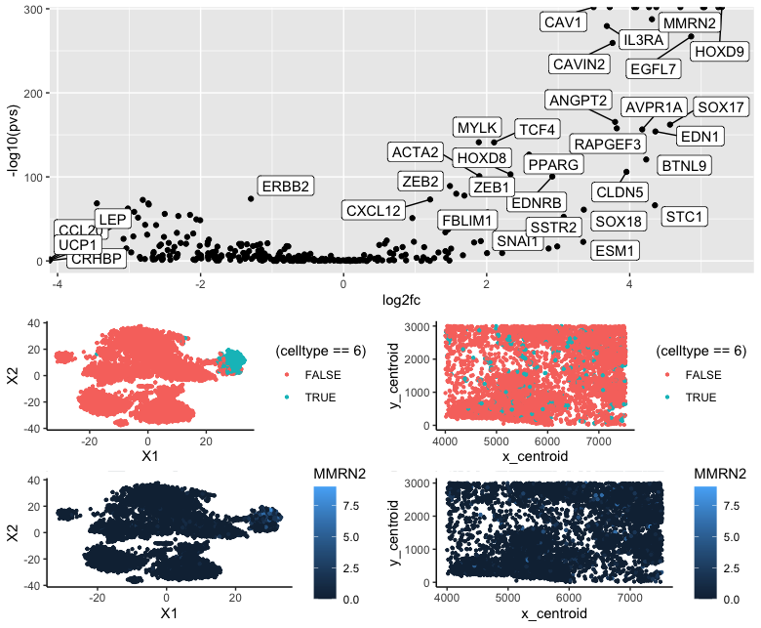

Slide 4
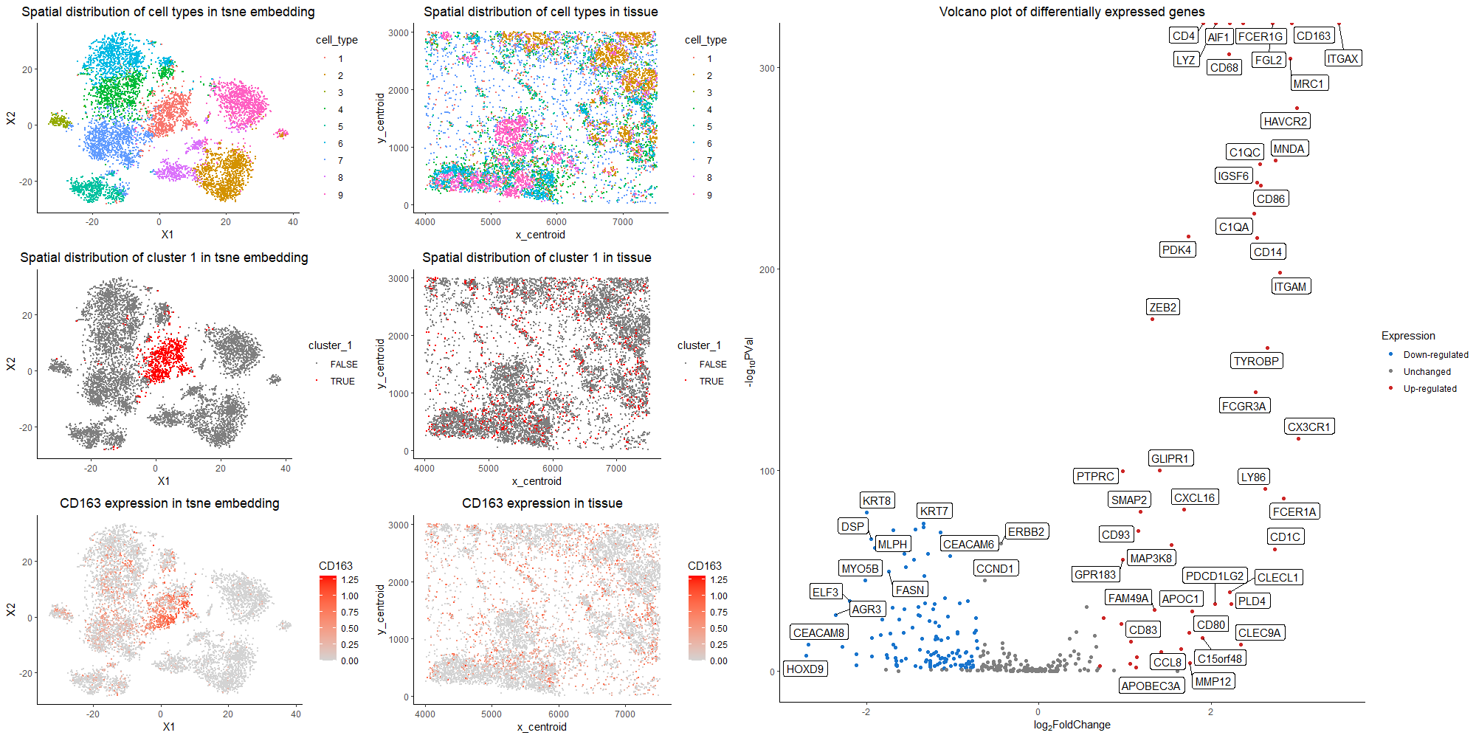

Slide 6

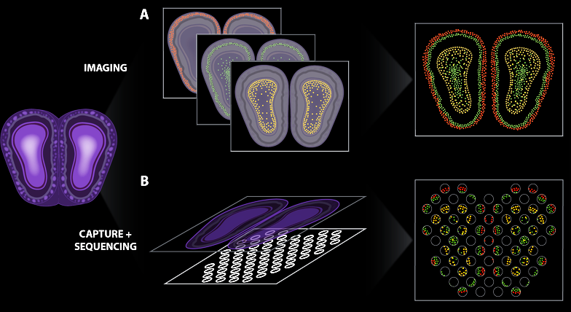
Many flavors of spatially resolved transcriptomic technologies
Lyla Atta
Targeted gene expression
At molecular resolution
Untargeted gene expression
At spot resolution
(Atta and Fan, Nature Communications, Sept 2021)
Notes:
different technologies
vary in terms of throughput, sensitivity, resolution
statistical analysis methods will be different

Slide 7
Limitations of imaging-based approaches

Slide 8
Next-gen sequencing based approaches

Slide 9
Spatial transcriptomics by spatially resolved capture + next-gen sequencing

Slide 10
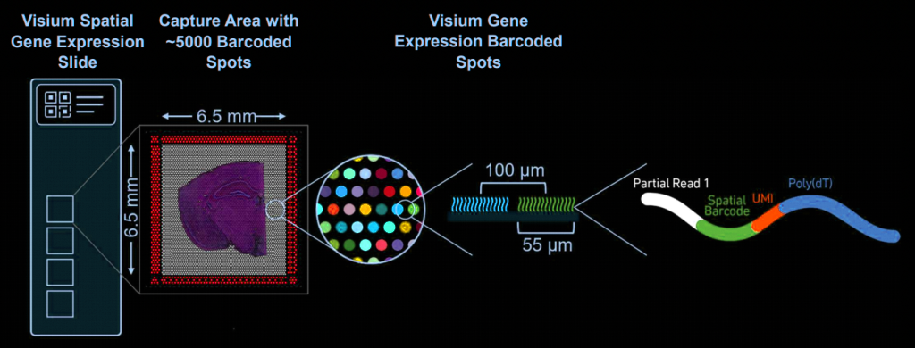
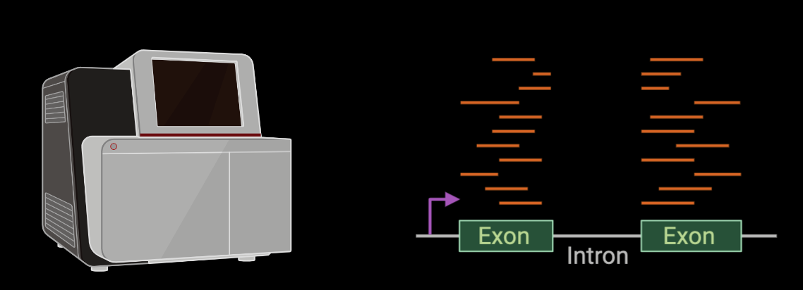
(ST/Visium: Stahl et al, Science 2016)
(SlideSeq: Rodriques et al, Science 2019)
(DbiT-Seq: Liu et al, Cell 2020)
(XYZseq: Lee et al, Science Advances 2021)

Slide 11
Quick check
What does it mean if I have two sequencing reads that map to different parts of the genome (or transcriptome) but have the same spatial barcode?

Slide 12
Quick check
What does it mean if I have two sequencing reads that map to the same parts of the genome (or transcriptome) and also have the same UMI?

Slide 13
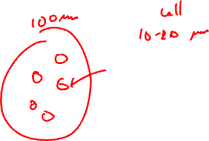
Quick check
Will I be able to tell if an RNA molecule is in the nucleus or cytoplasm of a cell using this data?

Slide 14
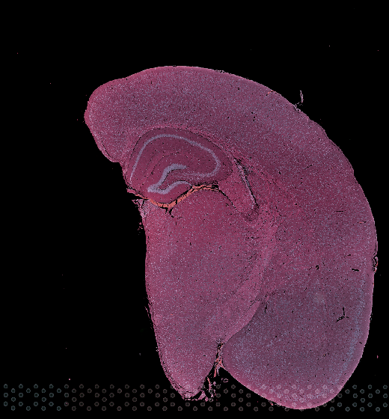

Slide 15
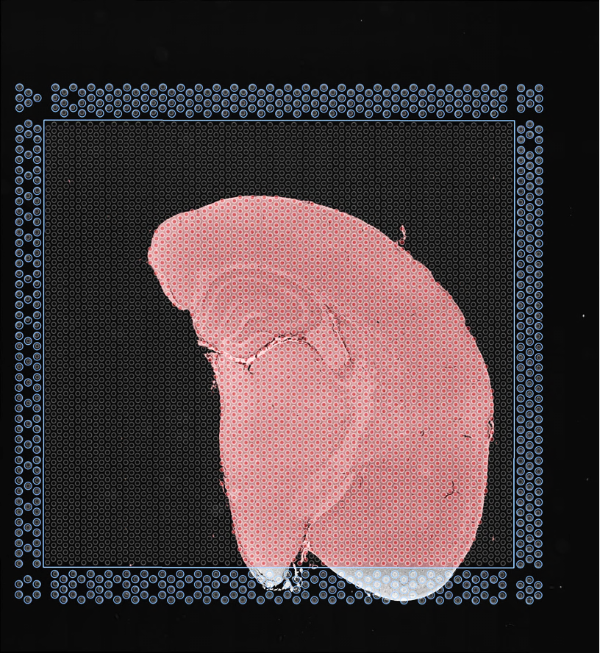
(Visium FFPE data)
Notes:
The measured gene expression at each spot comes from multiple cells potentially representing multiple cell types

Slide 16
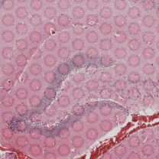
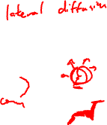
(Visium FFPE data)
Notes:
The measured gene expression at each spot comes from multiple cells potentially representing multiple cell types

Slide 17
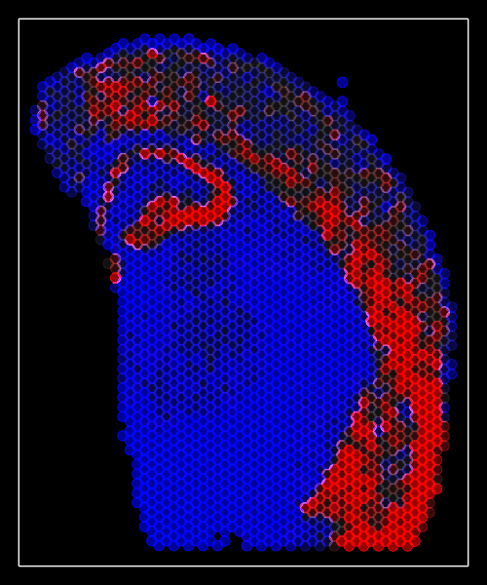
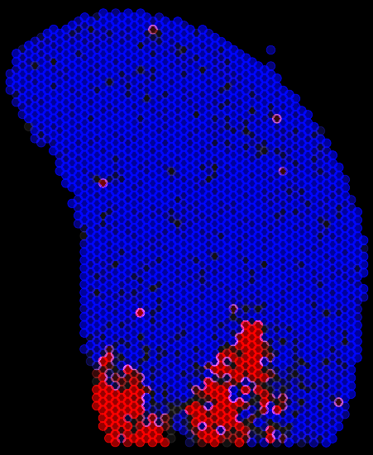
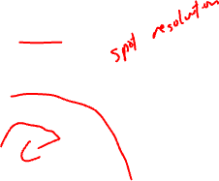
Slc17a7
Peg10
Untargeted
Full Transcriptome
Profiling
By Sequencing
(Visium FFPE data)
Notes:
so we can still apply the same analysis methods to identify
spatially heterogeneous genes

Slide 18
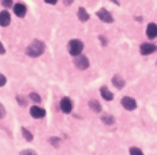
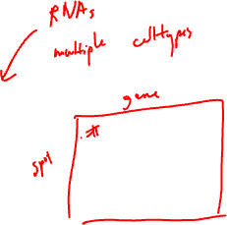
Pixels/spots comprise many cells; may comprise multiple cell-types
(Visium FFPE data)
Notes:
The measured gene expression at each spot comes from multiple cells potentially representing multiple cell types

Slide 19
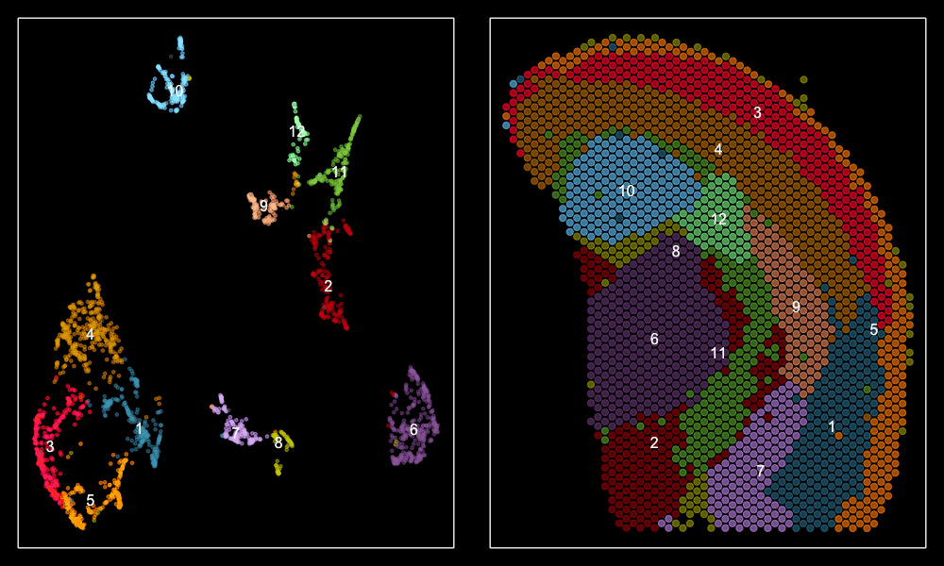

Pixels/spots comprise many cells; may comprise multiple cell-types
UMAP
(Visium FFPE data)
Notes:
The measured gene expression at each spot comes from multiple cells potentially representing multiple cell types
Hindering characterization of cell-type specific spatial organizational patterns

Slide 20

Quick check: my tissue is a mixture of 2 cell-types → how many clusters would I see if I perform clustering analysis?

Slide 21

Download data: bit.ly/GDV23_visiumBC

